Slide 1
Seq2Seq for Neural Machine Translation
Ibrahim DIDI
Sami SABAH
Salim BENCHELABI

Slide 2
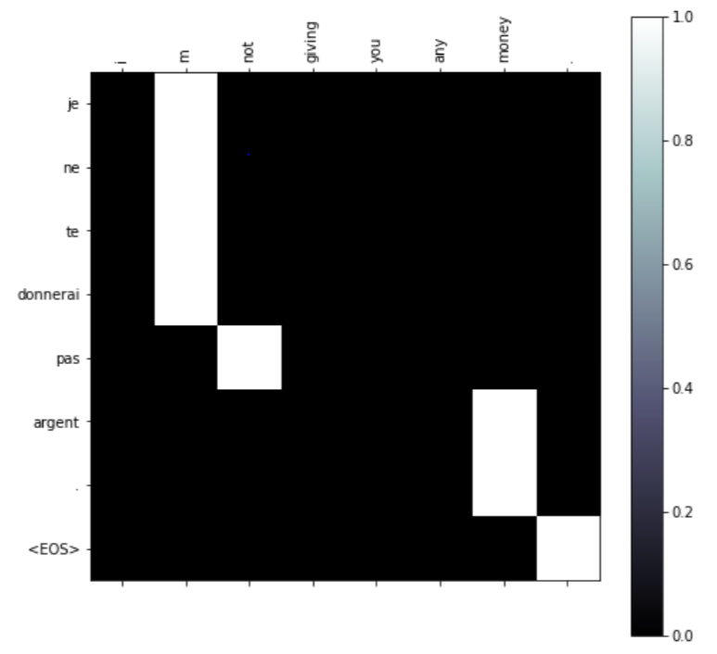
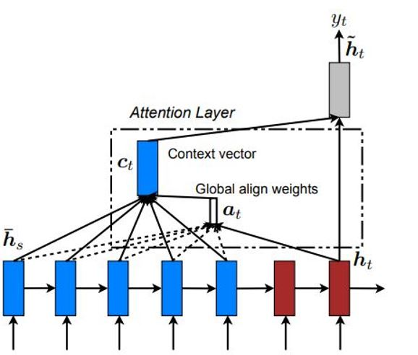
Presentation of the neural network

Slide 3
Evaluate the efficiency of the network
BLEU : bilingual evaluation understudy
Correspondence between a machine's output (candidate) and that of a human (reference)
Between 0 and 1

Slide 4
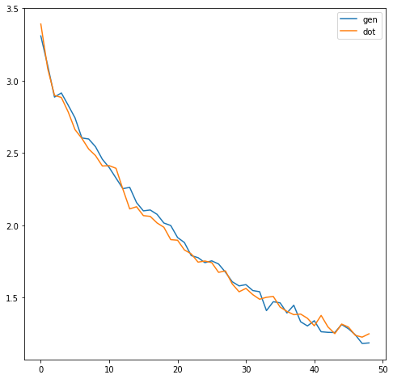
Impact of the attention score
Loss function
50 000 epochs

Slide 5
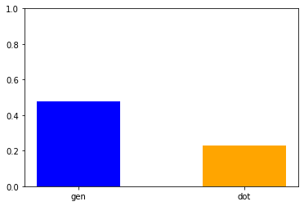
Impact of the attention score
BLEU score
Reference come from the same dataset

Slide 6
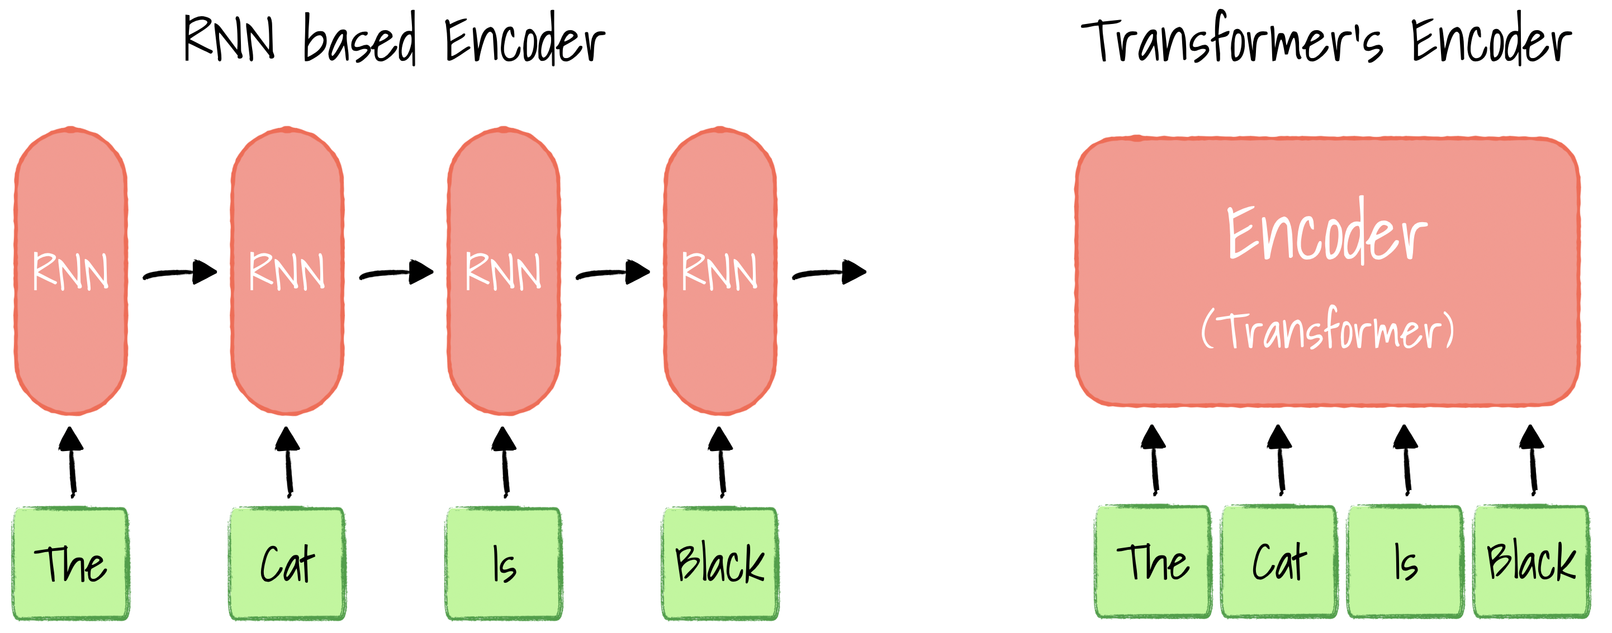
Attention is All You Need!
State of the art: Transformer based-models
Attention is all you need (A. Vaswani, N. Shazeer, N. Parmar, 2017)
Novel architecture: no RNNs!

Slide 7

Architecture of the model
No RNNs layers
Importance of positional encoding
Inputs are shifted right to not copy the decoder input!

Slide 8
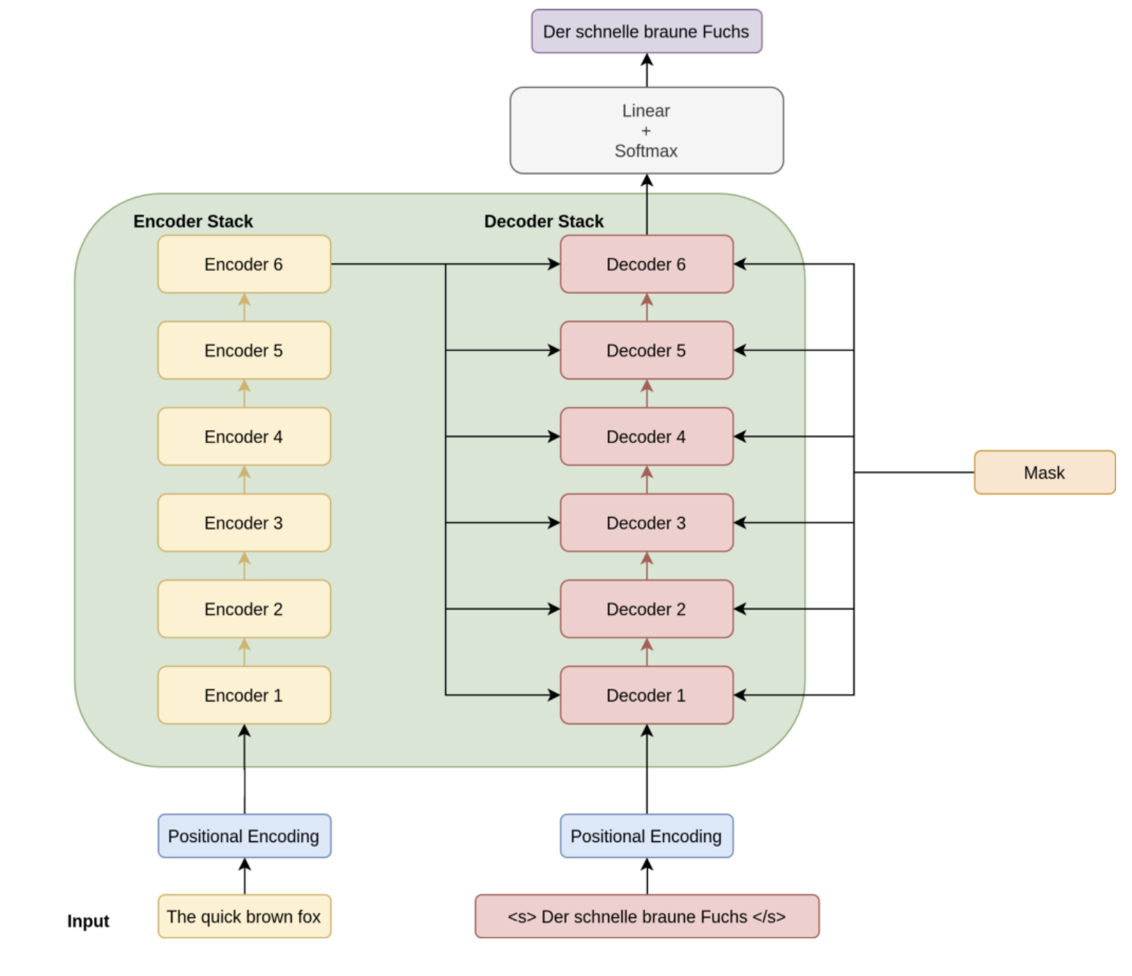
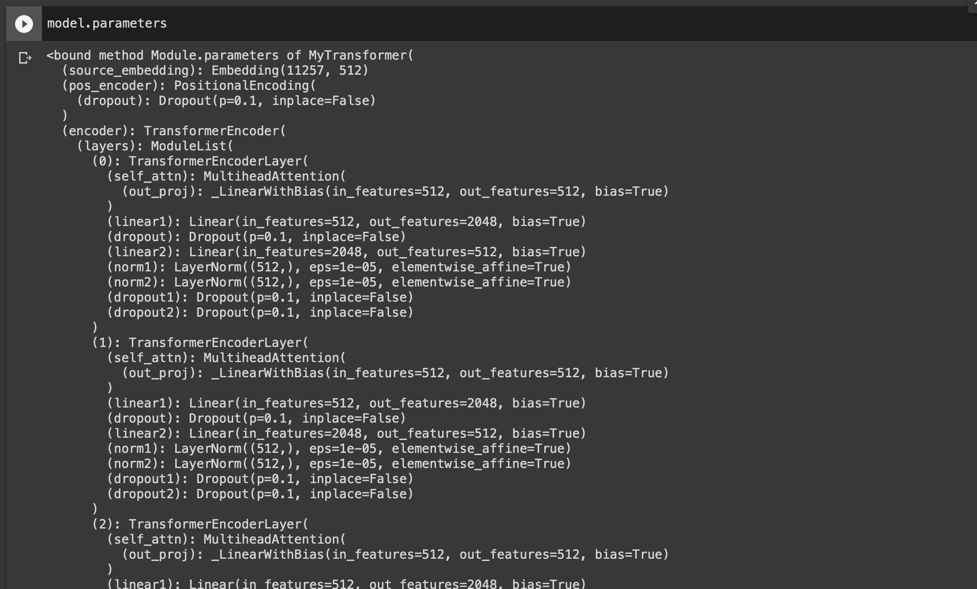
Architecture of the model

Slide 9
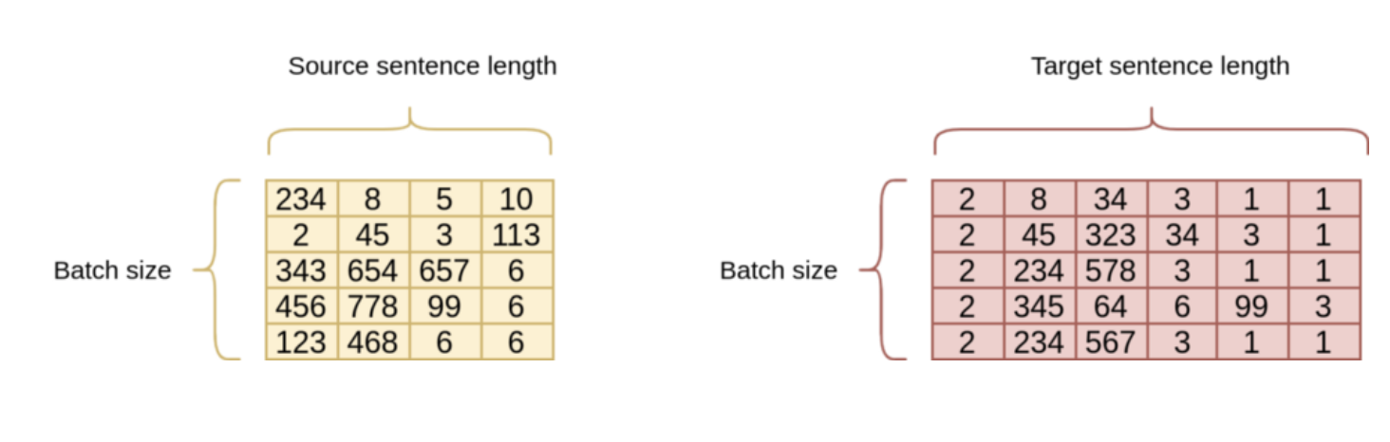
Data pre-processing
Different data pre-processing pipeline (torchtext)
Transfer learning vs training from scratch on our data
Problem of transfer learning: memory capacity!

Slide 10
Problems encountered and next steps
With transfer learning: memory usage!
With our data: adapting the data pre-processing pipeline to our data (still buggy)

